Slide 1
App Trader Proposal
Sprite team
Carroll, Cory, Evan, Katie D., Katie K.

Slide 2
Overview
General recommendations for Price
General recommendations for Genre
General recommendations for Content Rating
Top 10 list of apps to purchase for Black Friday

Slide 3
Recommendation for Target Price Range:
Free - $0.99
Because marketing costs and earnings do not vary based on the price of the app, the initial cost to purchase should be as low as possible.

Slide 4
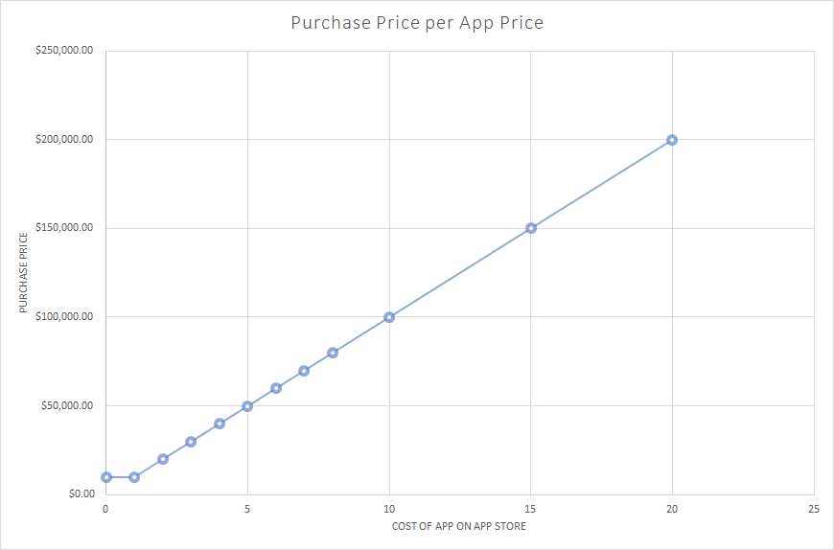
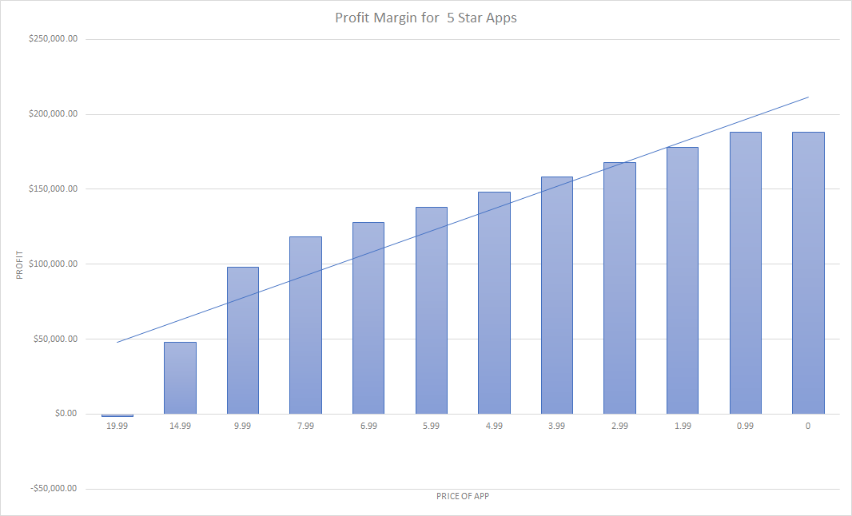
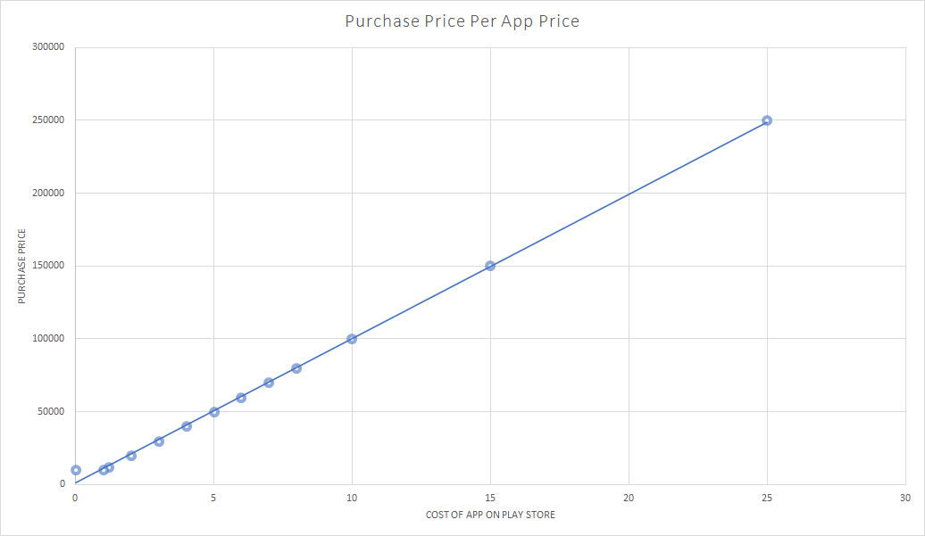
Target Price Range Information

Slide 5
Recommendation for Content Rating:
Everyone/4+
These apps are the most common and diverse amongst genres and will also appeal to all users

Slide 6
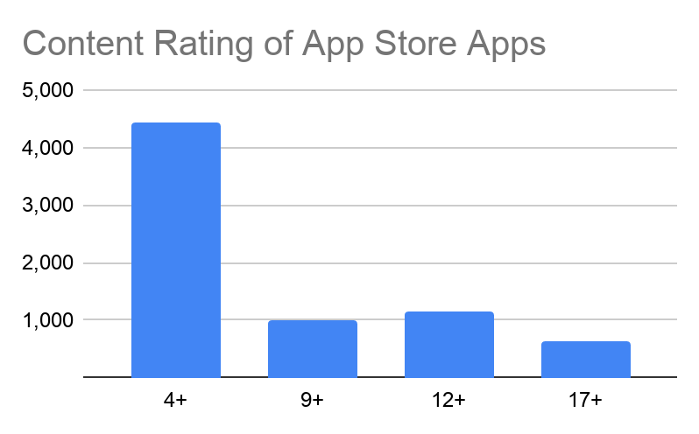
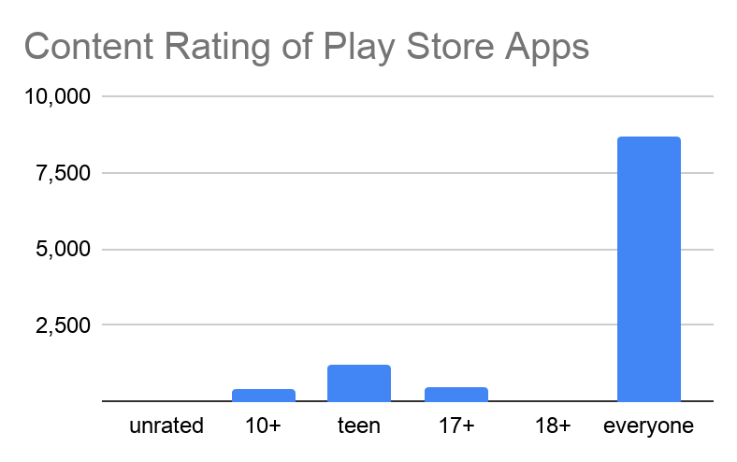
Content Rating Trends

Slide 7
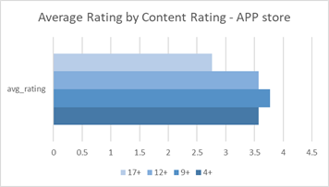
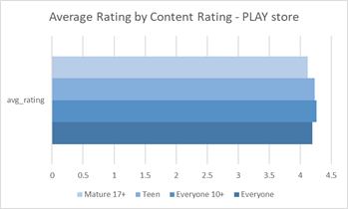
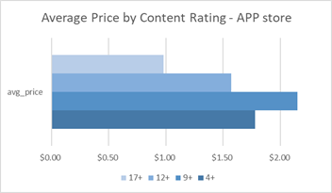
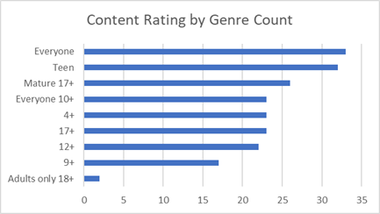
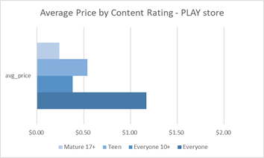
Content Rating Trends
There is much variation between ratings and prices in the APP store vs. the Play store based on content ratings.
Everyone and 4+ span the most genres in each store showing they are most diverse.

Slide 8
Recommendation for Genre:
Games
Games are the most common app category available and have the most ratings showing a high number of downloads

Slide 9
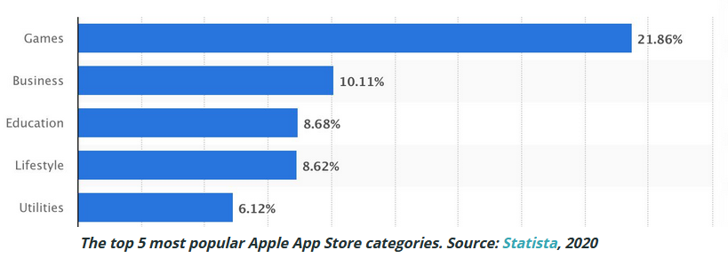
Why Game Apps?

Slide 10
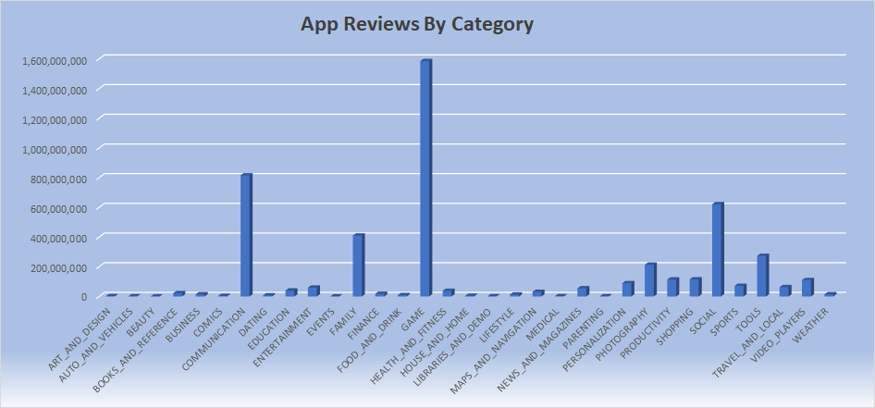
Why Game Apps?

Slide 11
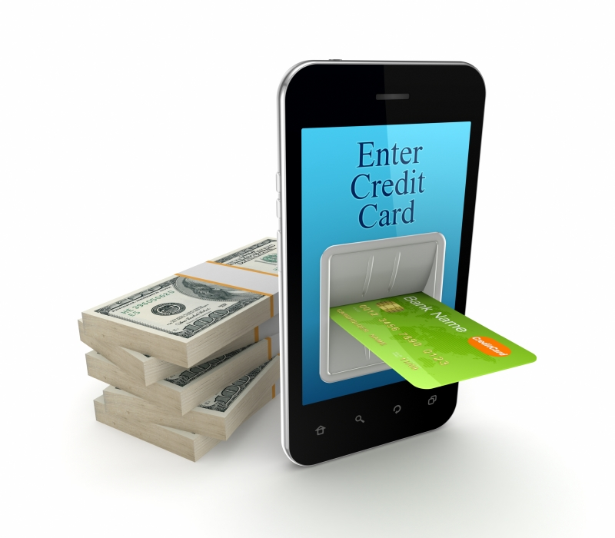
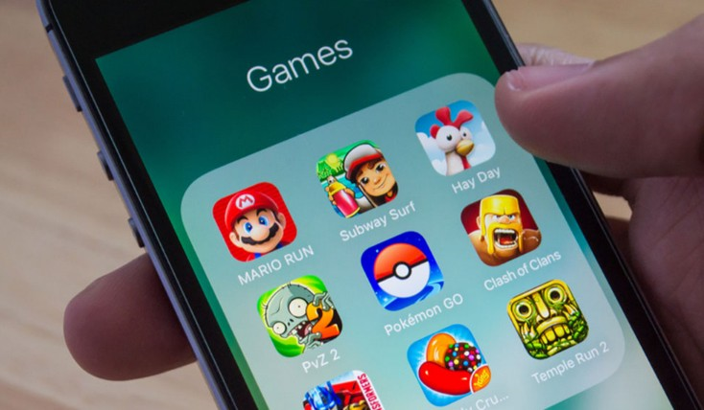
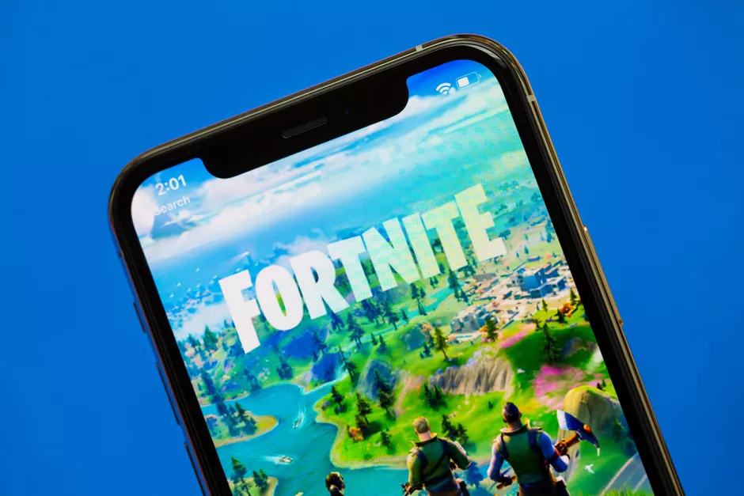
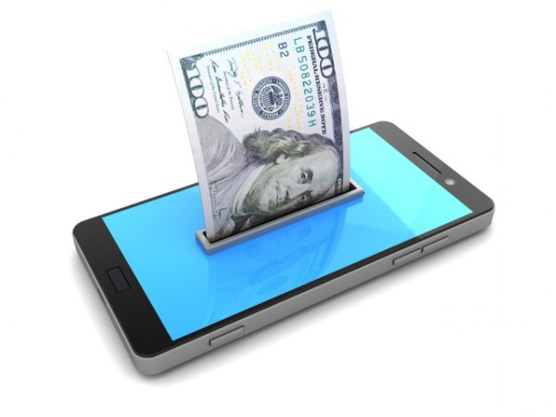
Why Game Apps?
Mobile games are big business. According to Newzoo, in 2020, mobile gaming will be worth $77.2 billion, generating almost half of global gaming revenues ($159.3 billion).
Mobile is the fastest-growing games segment (+13.3% YoY). Smartphones became the leading gaming platform, and the mobile gaming market has never been healthier.
Games have always been the most popular category in the Apple and Google app stores. Whatever way you care to slice it – number of active apps, number of downloads, time spent, revenue generated.
Games represent 10% of the users time spent on apps. On average, there are 8 games installed per mobile device in the US. Globally, the smartphone users play an average of 2 to 5 games per month.
Statista data reveals that games make up nearly ¹⁄₄ of all the active apps in the iOS App Store.

Slide 12
Recommendation for 10 apps to purchase :

Slide 13

List of Apps Chosen Key Points
Dominos Pizza USA---------------5 Stars - Free
ASOS---------------------------------5 Stars - Free
The Guardian ---------------------- 5 Stars - Free
PewDiePie’s Tuber Simulation--5 Stars - Free
Egg Inc. ------------------------------5 Stars - Free
Geometry Dash Lite --------------5 Stars - Free
Cytus --------------------------------5 Stars - $1.99
Clash of Clans --------------------- 4.5 Stars - Free
Clash Royale -----------------------4.5 Stars - Free
Bible ---------------------------------4.5 Stars - Free
Free apps have the lowest start-up cost
5-Star apps have the longest lifespan
Apps on both platforms decrease marketing cost

Slide 14
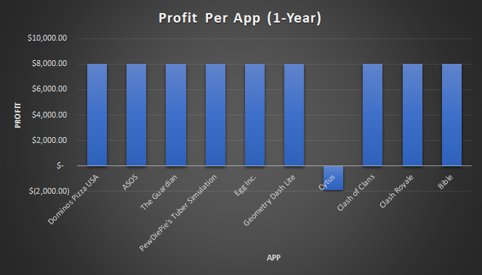
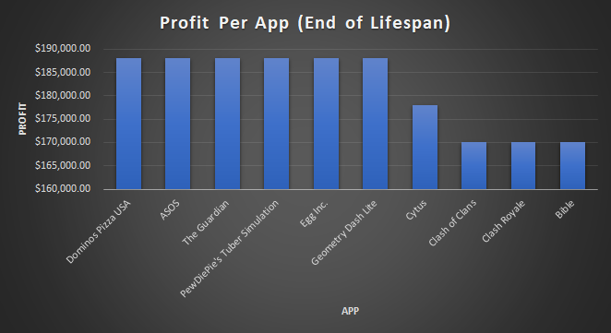
Yearly/Lifespan Profit Margin (Per App)

Slide 15
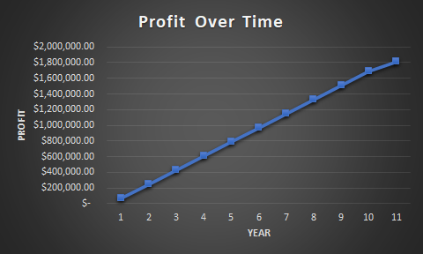
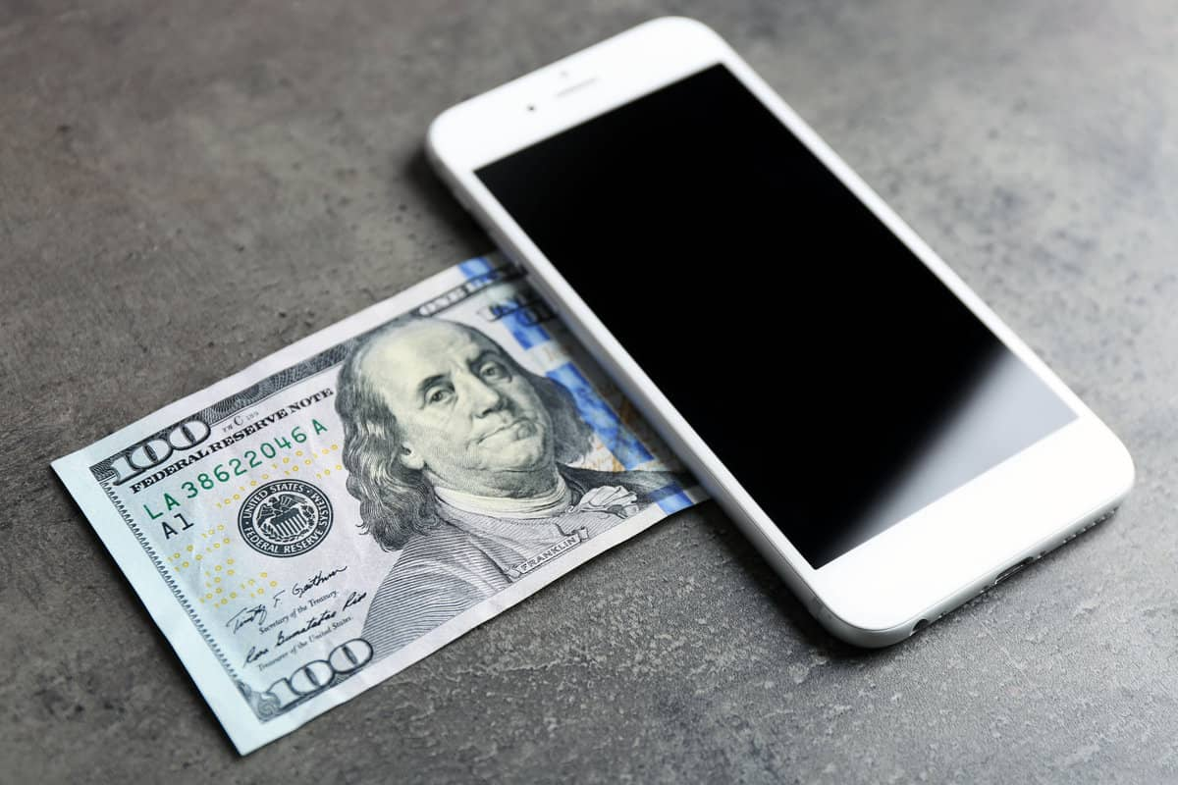
Total Profit Margin Over Time

Slide 16
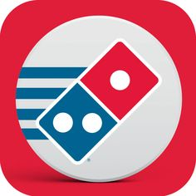









Overview of Total Start-up Costs/Profit
Start-up cost: $109,900.00
1-Year Profit: $70,100.00
End of Lifespan Profit: $1,816,000.00

